Slide 1
Nuclear A2D Design
Critical Design Review
Group #09
Kristen Berman
Joseph Nichols
Cassandra Todd
Michael Zellars
Notes:
K

Slide 2
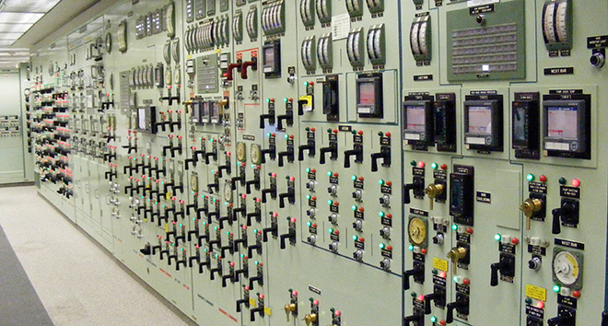
Project Motivation
Our group wanted a mentor/project sponsorship
ACTIVE Lab (Applied Cognition and Training in Immersive Virtual Environments) has a partnership with the NRC (Nuclear Regulatory Committee)
Nuclear power plants primarily contain outdated technology
The ACTIVE group will use our device to test a transition from analog to digital control technology
Notes:
K

Slide 3
Goals and Objectives
Create a working hard and soft panel that will support the ACTIVE group in their testing
Hard panel will consist of an extensive PCB design, multiple types of analog controls and needs to establish and maintain connectivity to the soft panel
Soft panel will be an accurate representation of the hard panel and needs to both accept inputs and send outputs to the hard panel
  In addition needs to establish and maintain connectivity with both the hard panel and the power plant simulator
We want to try to keep the hard panel to a reasonable size
Notes:
K

Slide 4
Specifications & Requirements
Hard Panel will consist of about 100 components (switches, push buttons, gauges and LED sectors)
Analog controls (Push buttons and switches) will need to be able to indicate current status
Power protection circuits will keep the panel temperature low and noise level maintained
Each device will be labeled with a 7 character alphanumeric string
Both panels need to be user friendly to appeal to the novice user but still remain customizable to adapt to the different testing environments needed by the ACTIVE group
All components will reside in a LAN
Soft panel will use UDP transmissions to communicate with the Power Plant Simulator
Notes:
K

Slide 5
System Block Diagram
Notes:
J

Slide 6
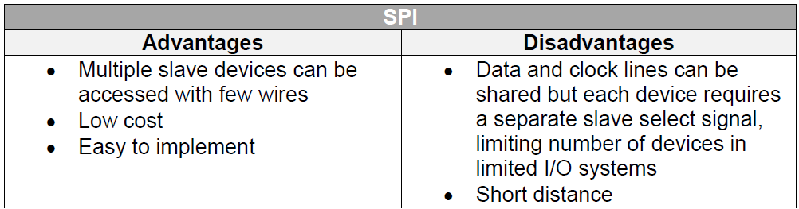
Microcontrollers
Master/Slave Configuration
  Our Master MCU will control two Slave MCU’s
    Master MCU – ATmega325 (used for overall control as well as push buttons & rotary switches)
    Slave #1 MCU – ATmega8 (used for control of gauge subsystem)
    Slave #2 MCU – ATmega32 (used for control of LED subsystem)
  Serial Peripheral Interface was chosen to execute this configuration
    Master will utilize SPI to transmit/receive data from the 2 slaves
Notes:
J

Slide 7
Microcontrollers
AVR Programming
  AVR Processors use RISC architecture – computers we will be using will run either x64 or x86 so a cross compiler is necessary
    To implement this we will use Atmel Studio 6 for Window’s PCs as well as the command line program AVRDUDE
  We will also use an Arduino Uno to program our AVR microcontrollers
    This supports in-system programming while designing our circuit
    Also, Arduino offers ArduinoISP firmware which provides us with tutorials and code to burn a bootloader onto an AVR
Notes:
J

Slide 8
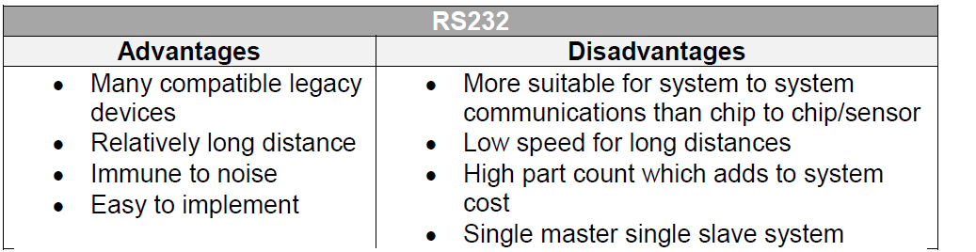
Microcontrollers
Communication
  In order to establish a connection between the Master MCU and the soft panel we will use the RS232 serial data standard

Slide 9
Housing Unit
Will require Acrylic and Sheet Metal
  Need to make sure to have smooth edges (no hazards)
  Acrylic will be used for casings around the gauges and the LED box
  Metal will be used for the overall housing unit
Positioning
  Light box sector needs to stretch across the top
  All other devices will be grouped together

Slide 10
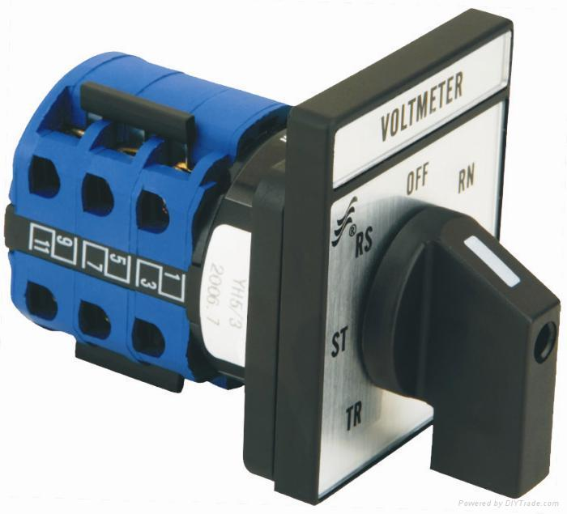
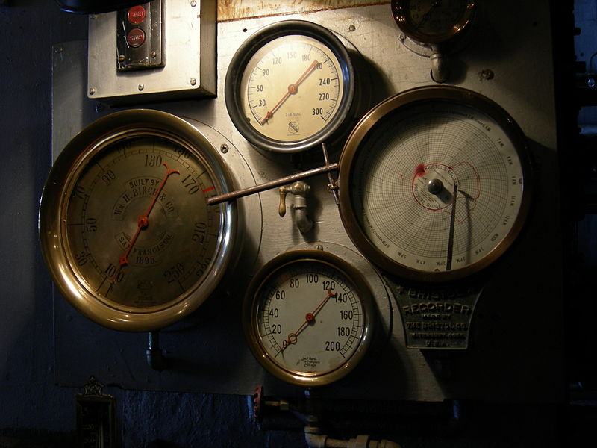
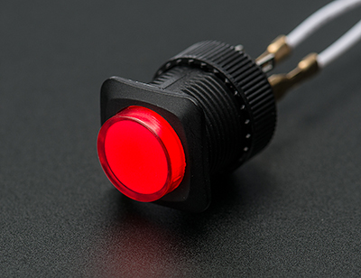
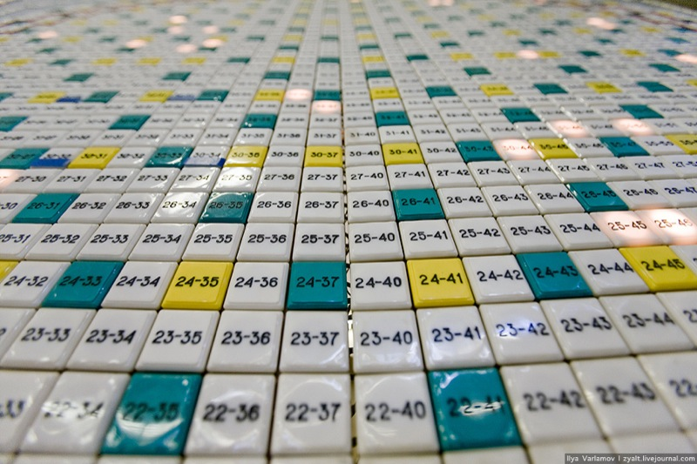
Analog Controls
Notes:
K

Slide 11
Analog Controls
26 Push Buttons have been purchased in both Red and Green colors and 25 Rotary Switches have been purchased
These items will be connected directly to the Master MCU and main PCB board
Due to their purely analog nature, they require status LED’s to indicate connectivity to the Soft Panel
Notes:
K

Slide 12
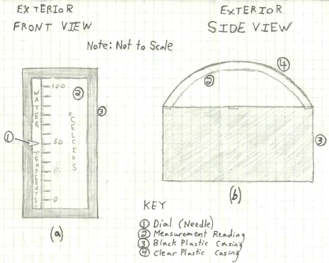
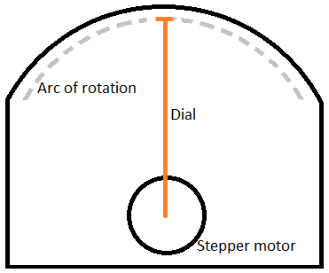
Analog Controls
Gauge Design
Notes:
M

Slide 13
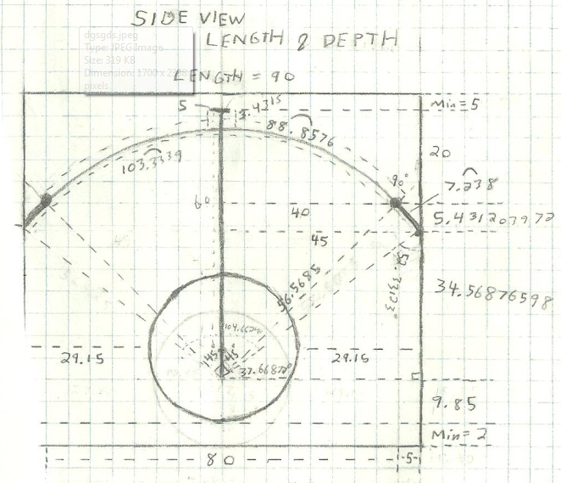
Detailed Gauge Design

Slide 14
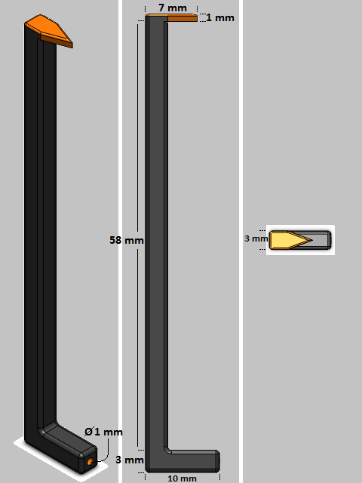
3D Print Job
Custom needle design via SolidWorks
24 needles to be printed
Material cost at $0.35 / cm³
≈ $5.09

Slide 15
Analog Controls
LED Box Design
Notes:
C

Slide 16
Hardware Block Diagram
Notes:
C

Slide 17
Power Circuit
Design Requirements | Solution
Plug and play | Take power directly from wall outlet
Operating Voltages 3-5VDC | AC-DC buck boost converter
Isolated source | Chopper circuit and feedback controller
Notes:
C

Slide 18
Printed Circuit Board Design
Each subsystem will be placed onto its own PCB
3 boards in total will be designed
  Master MCU, power circuit, rotary switches and push buttons
  Gauges subsystem
  LED subsystem
Separating into subsystems cuts down on issues to potentially be found and will hopefully make testing each subsystem easier
All PCB work will be designed in EAGLE design software and sent to a manufacturer for assembly

Slide 19
Software Block Diagram
Notes:
M

Slide 20
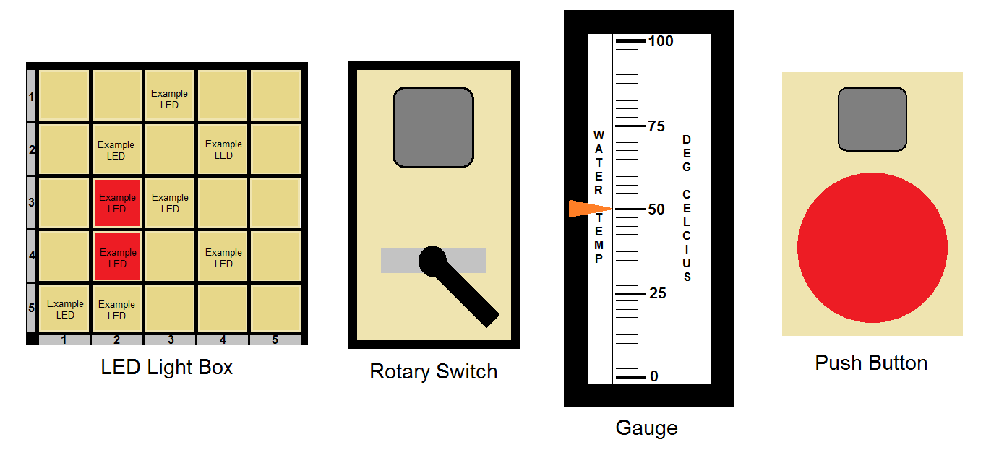
Soft Panel
The GUI
LED sector
Switches
Gauges
Push Buttons

Slide 21
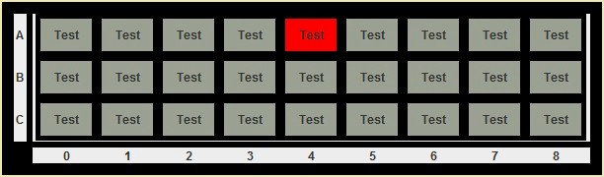
LED Sector
Three states:
  On
  Off
  Flashing

Slide 22
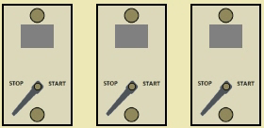
Switches
  Lever is moved by clicking and dragging
  Status LED indicates on or off

Slide 23
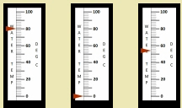
Gauges
  Precision
  Smooth movement
    Pointer acceleration and deceleration will be implemented in the future

Slide 24
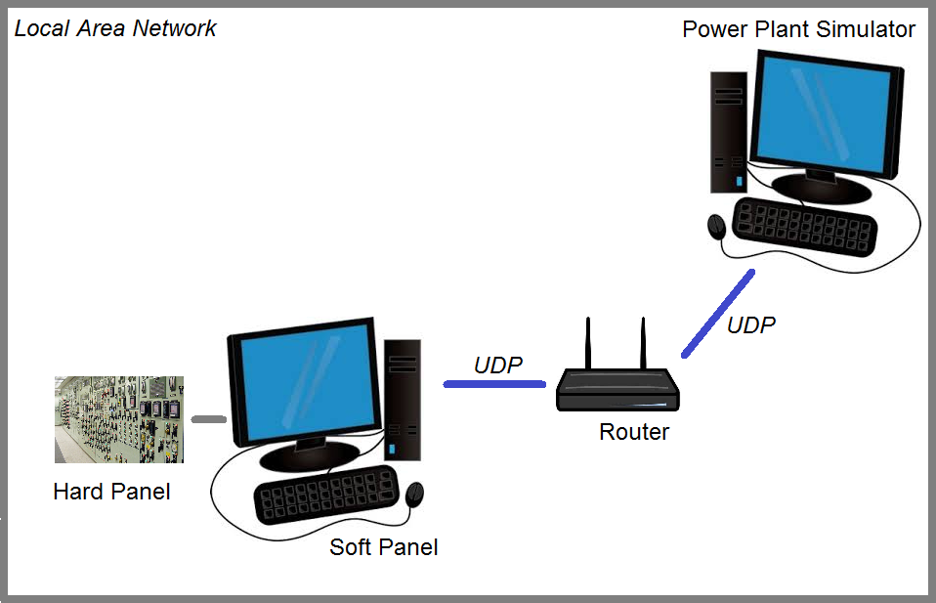
Power Plant Simulator
Java-based application running on a separate PC
Handles user input
  Button pushing
  Switching
Returns output to control panels
  Change in gauge states
  Change in LED states

Slide 25
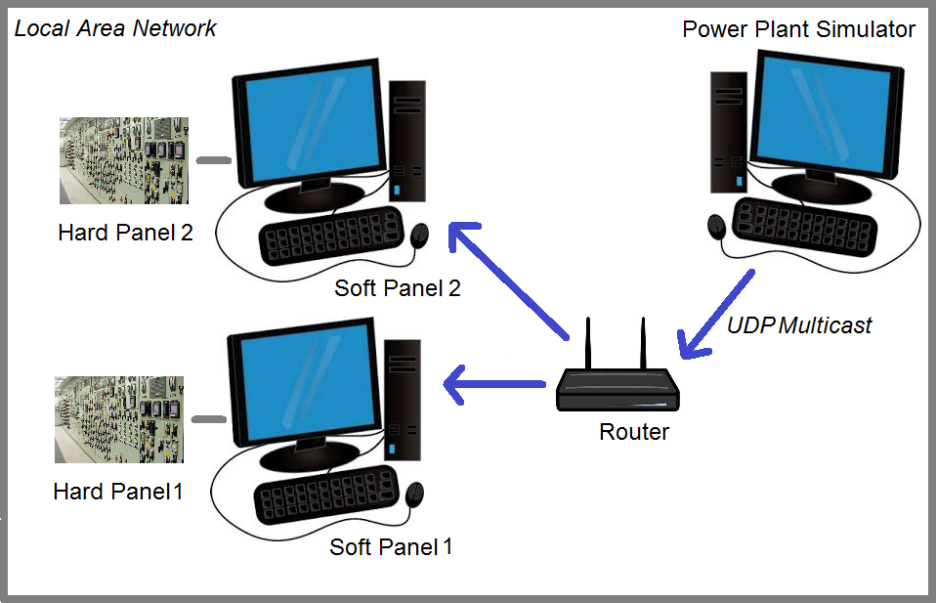
UDP Multicasting
Power Plant Simulator sends each output command with a UDP multicast
This means that every control panel within the network receives the same transmission
Multicasting is used to keep network traffic minimal and ensure the system is in sync

Slide 26
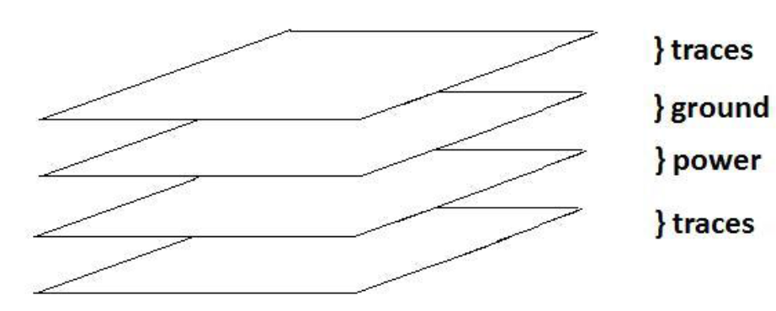
Design Decisions
4 Layer PCB
  Most important decision for a PCB is the number of layers
  The 2 PCB’s that support the gauges and LED subsystems will each be double-sided
  The 3rd PCB will have a more complex design and will therefore require more layers
    2 signal layers, a ground layer and a power layer

Slide 27
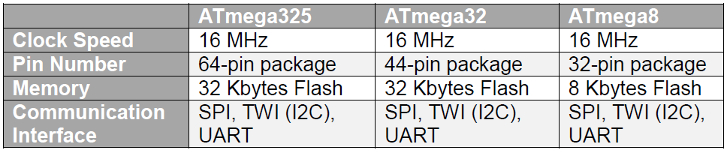
Design Decisions
Microcontrollers
  Our hardware design is centered on the ATMega series of microcontrollers
  The table outlines the 3 microcontrollers that were selected and key characteristics

Slide 28
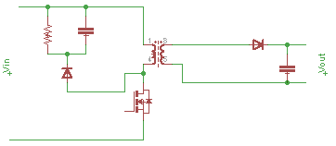
Design Decisions
Power circuit
  Isolated Flyback Buck Boost Converter
    Industry Standard
    Can Perform both buck and boost operations
    More efficient design
      Better at conserving energy
      Capable of storing energy during on state of system

Slide 29
Current Successes & Difficulties
Working Gauge Prototype
90% of parts are ordered
Tentative Soft Panel Layout
Staying under budget
PCB Accuracy – Fear of a short
Generation of excessive heat during the DC-DC transformation
Main regulated voltage won’t be 3.3V @350mA
Potentially might need an LED driver to provide a constant current source

Slide 30
Project Budget
Item | Quantity | Cost | Purchased?
Push Buttons | 26 | $39
Switches | 25 | $172.50
Stepper Motors | 25 | $70
Shift Registers | 15 | $7.20
Light Box LED’s | 25 | $18.50
Indicator LED’s | 26 | Quoting | X
MCU’s | 9 | Free
PCB | 4 Layers | $200 | X
Housing Unit Metal & Acrylic | Quoting | $70 | X
Electrical Components | Various | $80
Cords | 3 | $45
Electrical Grounding Equipment | 3 | $20
Total Funding Allotted: $991.25
Total Amount Spent: $493.32
Amount Projected Left to Spend: $335
Amount Estimated to Save: $162.93

Slide 31
Work Roles
Team Member | Work Distribution
Kristen | System Communication & Administrative Content
Joe | Primary PCB Design & MCU Configuration
Cassie | Power Circuit & LED Circuit Design
Mike | Primary Software Engineer & Gauge Design

Slide 32
Current Progress

Slide 33
Immediate Plans
Aiming to have PCB orders in by January 31st
Will finish up remaining part orders by the 31st as well
February will transition into a coding focus – MCU & Soft Panel

Slide 34


Special Thanks

Slide 35
Questions?

